Slide 1
Trends in Assessment:
Enduring Principles, Emerging Opportunities
Stephen P. Hundley, Ph.D.
Founding Executive Director, Center for Leading Improvements in Higher Education
Professor of Organizational Leadership
Chair, Assessment Institute in Indianapolis
IUPUI

Slide 2
Session Resources
Website:
https://go.iu.edu/8our
QR Code:
IUPUI

Slide 3
About Stephen
Professor of Organizational Leadership
Serve as Founding Executive Director of the Center for Leading Improvements in Higher Education:
Chair of the Assessment Institute in Indianapolis, Editor of Assessment Update, Series Editor of the Assessment and Improvement book series, and Host of Leading Improvements in Higher Education podcast
Prior leadership roles: Program Director, Department Chair, Associate Dean, Interim Dean, Associate Vice Chancellor, Interim Chief Enrollment Officer, and Senior Advisor to the Chancellor
IUPUI

Slide 4
Learning Goals for Our Time Together
Upon conclusion of this session, you should be able to:
Explain the importance of assessment and its significance to higher education
Identify some enduring principles related to assessment
Describe some emerging opportunities for assessment
Promote a culture of assessment and improvement in your context
Use resources from the Assessment Institute in Indianapolis and elsewhere
IUPUI

Slide 5
About the Assessment Institute in Indianapolis
The oldest and largest U.S. event focused on assessment and improvement
Assessment Update, a bimonthly periodical with Wiley
Assessment and Improvement Book Series with Routledge/Taylor & Francis
Leading Improvements in Higher Education podcast
Free Webinar Series offered from throughout the year via Zoom
Partnerships with several national associations and research organizations
Resources: go.iu.edu/assessmentinstitute
IUPUI
Notes:
Core campus, and one of 7 campuses, of Indiana University.
IUPUI was founded in 1969 and is the result of a merger of the Purdue Indianapolis Extension Center and Indiana University Indianapolis
Offers more than 450 undergraduate, graduate, and professional programs from Indiana University and Purdue University.
29,000+ students
More than 8,000 faculty and staff
We are a Division I school (Horizon League) and offer 16 varsity teams.

Slide 6
Initial Discussion
What is assessment?
Why is assessment important?
How is assessment used in your context?
IUPUI

Slide 7
Enduring Principles
IUPUI

Slide 8
Definition/Purpose of Assessment
Systematic analysis of credible evidence involving:
Resources (faculty, students, facilities, budgets, etc.)
Processes (curriculum, teaching, instructional technology, services, etc.)
Outcomes (learning, program effectiveness, institutional effectiveness, etc.)
To improve:
Institution-level instruction
Program-level instruction
Course- and activity-level instruction
Assignment-level instruction
Services, experiences, and operations in higher education
Student learning and success
IUPUI
Notes:
Core campus, and one of 7 campuses, of Indiana University.
IUPUI was founded in 1969 and is the result of a merger of the Purdue Indianapolis Extension Center and Indiana University Indianapolis
Offers more than 450 undergraduate, graduate, and professional programs from Indiana University and Purdue University.
29,000+ students
More than 8,000 faculty and staff
We are a Division I school (Horizon League) and offer 16 varsity teams.

Slide 9
Watchwords for Higher Education in 2024
Relevance
Evidence
Perseverance
IUPUI
Notes:
Core campus, and one of 7 campuses, of Indiana University.
IUPUI was founded in 1969 and is the result of a merger of the Purdue Indianapolis Extension Center and Indiana University Indianapolis
Offers more than 450 undergraduate, graduate, and professional programs from Indiana University and Purdue University.
29,000+ students
More than 8,000 faculty and staff
We are a Division I school (Horizon League) and offer 16 varsity teams.

Slide 10
Significance of Assessment
Concern about the real costs of college
Concern about the opportunity costs of college
Concern about evidence of collegiate outcomes
Concern about governmental, employer, and societal expectations of graduates
Concern about the return-on-investment of a college degree
Other concerns?
IUPUI
Notes:
Core campus, and one of 7 campuses, of Indiana University.
IUPUI was founded in 1969 and is the result of a merger of the Purdue Indianapolis Extension Center and Indiana University Indianapolis
Offers more than 450 undergraduate, graduate, and professional programs from Indiana University and Purdue University.
29,000+ students
More than 8,000 faculty and staff
We are a Division I school (Horizon League) and offer 16 varsity teams.

Slide 11
Significance of Assessment
Feedback from stakeholders
Productivity measures and cost analyses
Accreditation, program review, and peer review feedback
Rankings, reputation, and stakeholder engagement
Student achievement of learning outcomes:
What do we want students to know/be able to do upon completion of ___?
IUPUI
Notes:
Core campus, and one of 7 campuses, of Indiana University.
IUPUI was founded in 1969 and is the result of a merger of the Purdue Indianapolis Extension Center and Indiana University Indianapolis
Offers more than 450 undergraduate, graduate, and professional programs from Indiana University and Purdue University.
29,000+ students
More than 8,000 faculty and staff
We are a Division I school (Horizon League) and offer 16 varsity teams.

Slide 12
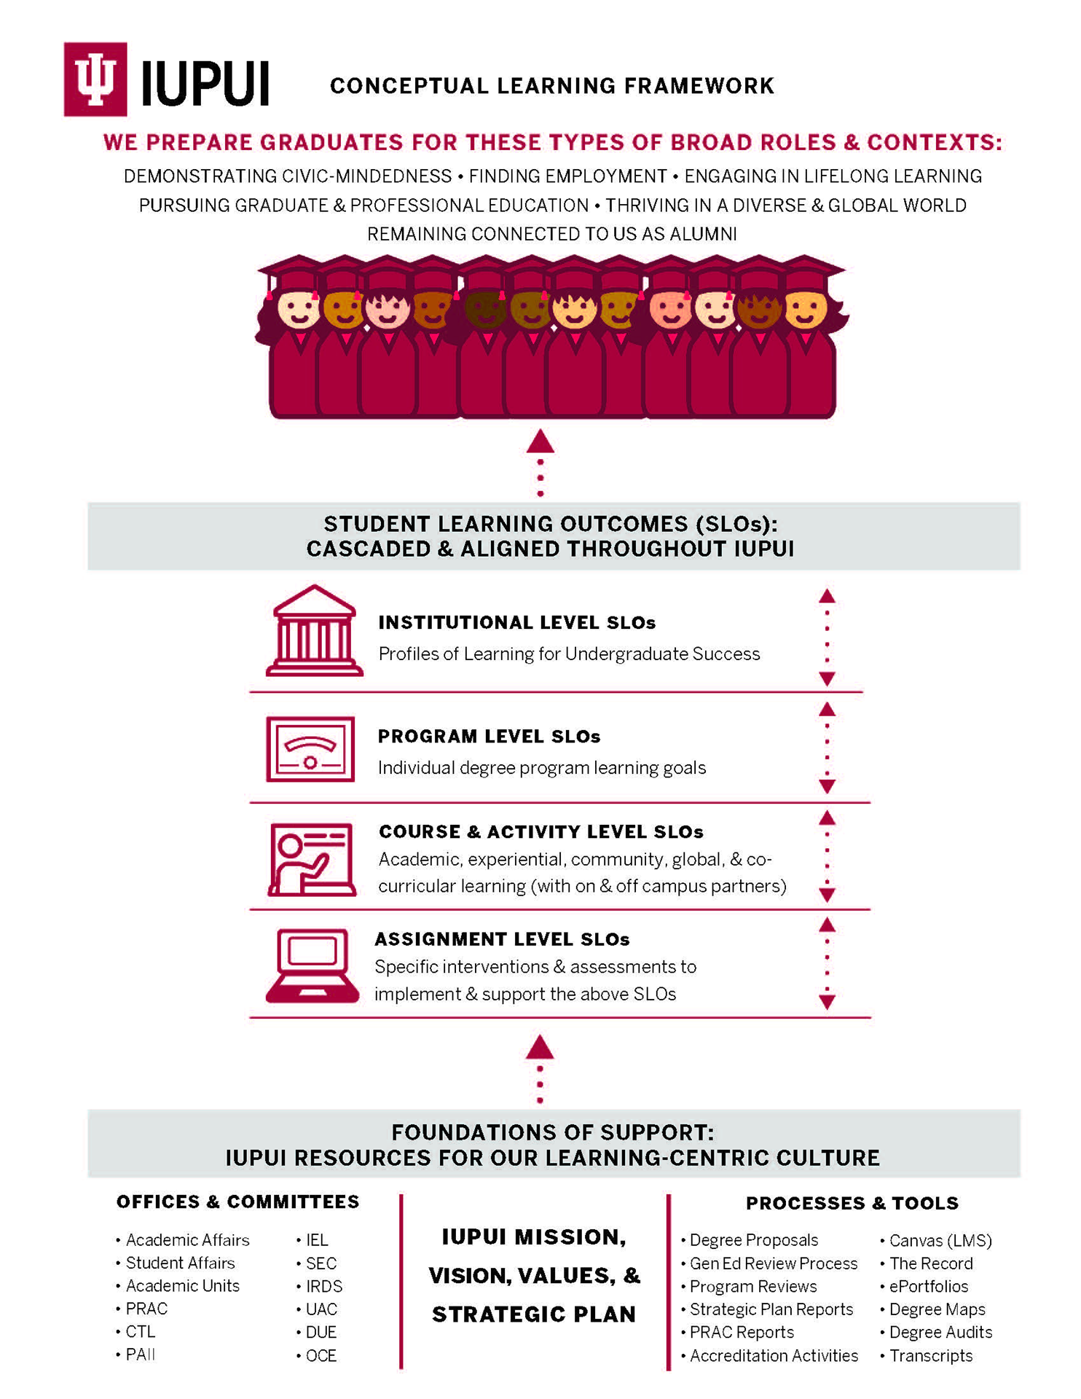
IUPUI
Notes:
Core campus, and one of 7 campuses, of Indiana University.
IUPUI was founded in 1969 and is the result of a merger of the Purdue Indianapolis Extension Center and Indiana University Indianapolis
Offers more than 450 undergraduate, graduate, and professional programs from Indiana University and Purdue University.
29,000+ students
More than 8,000 faculty and staff
We are a Division I school (Horizon League) and offer 16 varsity teams.

Slide 13
Goals for Higher Education Graduates
Demonstrating civic mindedness
Finding employment
Engaging in lifelong learning
Pursuing graduate and professional education
Thriving in a diverse and global world
Remaining connected to us as alumni
IUPUI
Notes:
Core campus, and one of 7 campuses, of Indiana University.
IUPUI was founded in 1969 and is the result of a merger of the Purdue Indianapolis Extension Center and Indiana University Indianapolis
Offers more than 450 undergraduate, graduate, and professional programs from Indiana University and Purdue University.
29,000+ students
More than 8,000 faculty and staff
We are a Division I school (Horizon League) and offer 16 varsity teams.

Slide 14
Institutional-level Student Learning Outcomes
What we expect students of any program to know and be able to do at the time of graduation from our institution
These institutional student learning outcomes are often introduced in First Year Experiences and General Education Courses
They get reinforced in discipline-specific, inter- and multi-disciplinary courses, and through other venues for learning, including the co-curriculum
Example: Our campus’ Profiles of Learning for Undergraduate Success
IUPUI
Notes:
Core campus, and one of 7 campuses, of Indiana University.
IUPUI was founded in 1969 and is the result of a merger of the Purdue Indianapolis Extension Center and Indiana University Indianapolis
Offers more than 450 undergraduate, graduate, and professional programs from Indiana University and Purdue University.
29,000+ students
More than 8,000 faculty and staff
We are a Division I school (Horizon League) and offer 16 varsity teams.

Slide 15
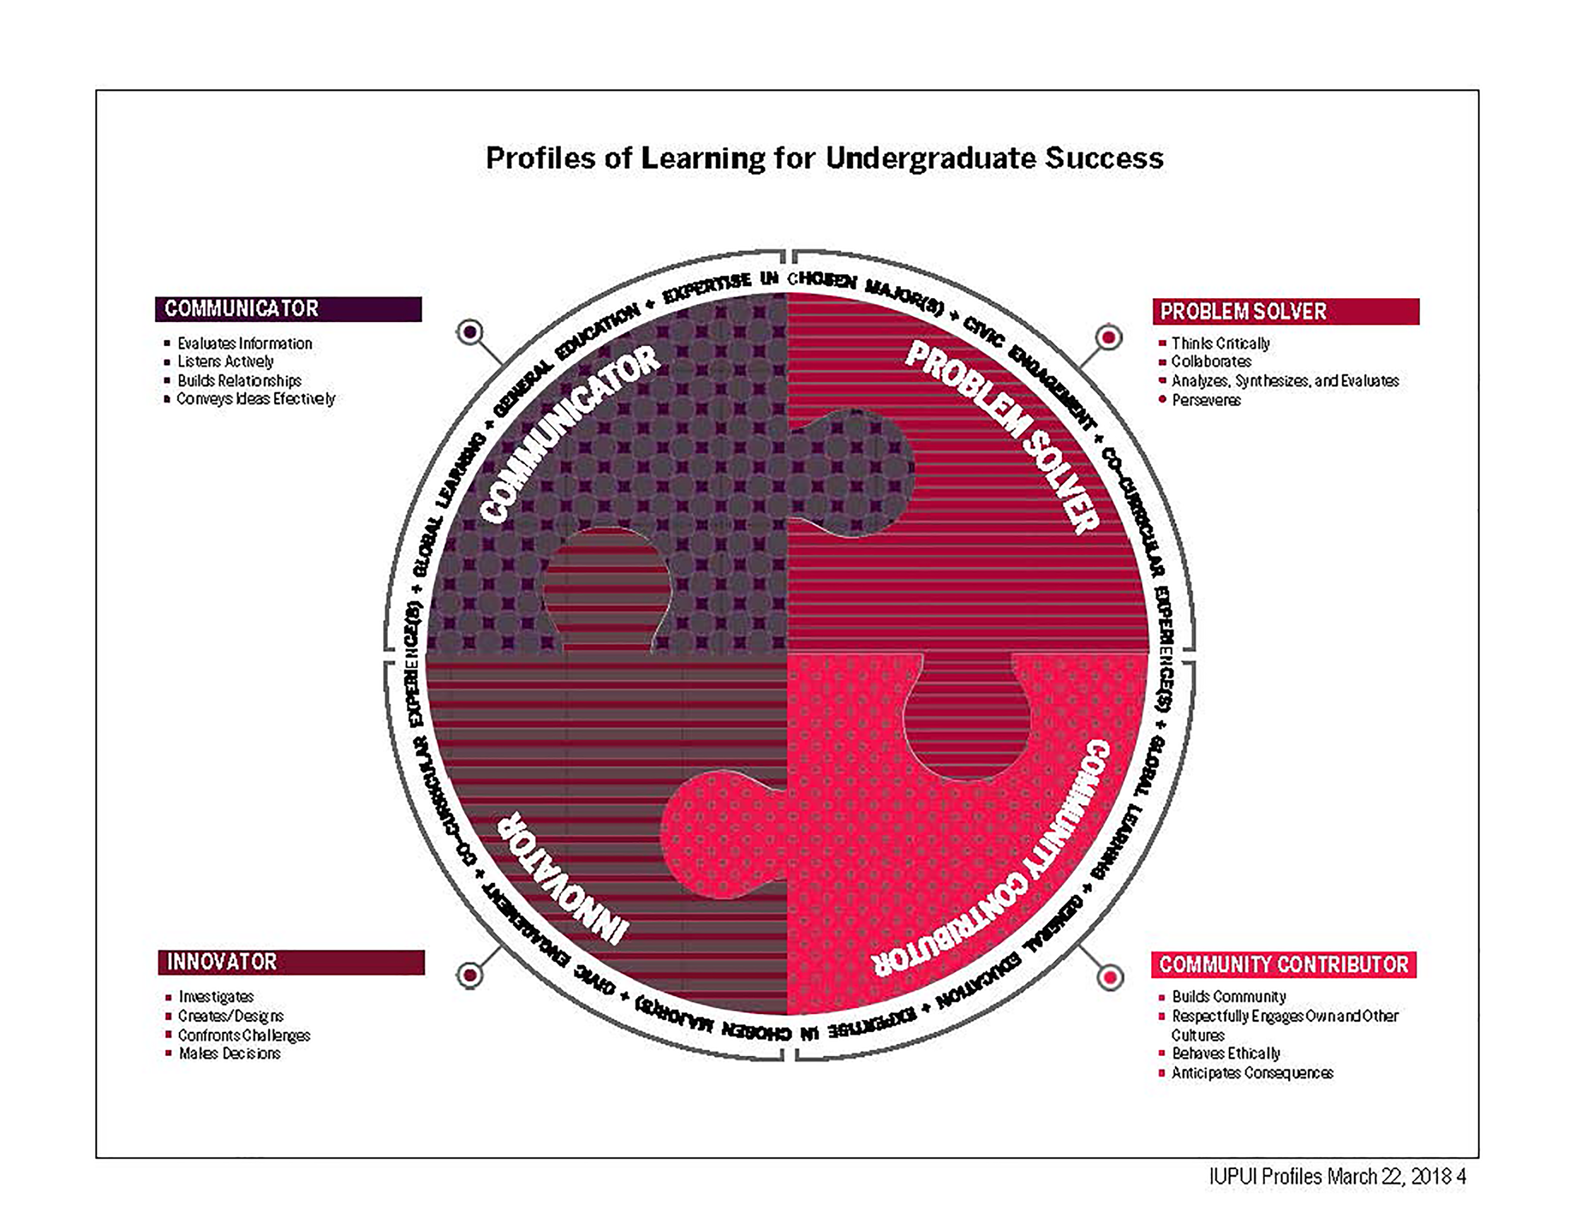
IUPUI
Notes:
Core campus, and one of 7 campuses, of Indiana University.
IUPUI was founded in 1969 and is the result of a merger of the Purdue Indianapolis Extension Center and Indiana University Indianapolis
Offers more than 450 undergraduate, graduate, and professional programs from Indiana University and Purdue University.
29,000+ students
More than 8,000 faculty and staff
We are a Division I school (Horizon League) and offer 16 varsity teams.

Slide 16
Program-level Student Learning Outcomes
What students should know and be able to do upon completion of a specific academic program (degree, certificate, minor, or credential)
Program-level learning outcomes should be derived from and aligned with institutional-level learning outcomes
Curriculum mapping is a useful way to identify the courses in which learning outcomes get introduced, reinforced, and/or assessed
Program-level learning outcomes also inform course- and activity-level learning outcomes
IUPUI
Notes:
Core campus, and one of 7 campuses, of Indiana University.
IUPUI was founded in 1969 and is the result of a merger of the Purdue Indianapolis Extension Center and Indiana University Indianapolis
Offers more than 450 undergraduate, graduate, and professional programs from Indiana University and Purdue University.
29,000+ students
More than 8,000 faculty and staff
We are a Division I school (Horizon League) and offer 16 varsity teams.

Slide 17
Course- and Activity-level Student Learning Outcomes
These include academic, experiential, community, global, and co-curricular learning (with on- and off-campus partners)
Course-level learning outcomes should be derived from and aligned with the program- and institutional-level learning outcomes
Activity-level learning outcomes are the comparable interventions occurring in out-of-class settings
Issues include course creep, multi-section alignment, and instructor style and emphasis
IUPUI
Notes:
Core campus, and one of 7 campuses, of Indiana University.
IUPUI was founded in 1969 and is the result of a merger of the Purdue Indianapolis Extension Center and Indiana University Indianapolis
Offers more than 450 undergraduate, graduate, and professional programs from Indiana University and Purdue University.
29,000+ students
More than 8,000 faculty and staff
We are a Division I school (Horizon League) and offer 16 varsity teams.

Slide 18
Assignment-level Student Learning Outcomes
Assignments are ways in which course-level learning is assessed
Quality of assignment design and explicit relationship to learning goals are necessary (e.g., Transparency in Learning and Teaching, or TiLT; use of rubrics)
Everything we ask students to do, assignment-wise, should intentionally scaffold to a course-level learning goal
Issues include clarity of assignment, implementation fidelity, and periodic review of all assignments in courses/programs to ensure intended instructional approaches are appropriate (e.g., individual vs. group work; foundation-intermediate-advanced assignments; use of High Impact Practices, or HIPs)
IUPUI
Notes:
Core campus, and one of 7 campuses, of Indiana University.
IUPUI was founded in 1969 and is the result of a merger of the Purdue Indianapolis Extension Center and Indiana University Indianapolis
Offers more than 450 undergraduate, graduate, and professional programs from Indiana University and Purdue University.
29,000+ students
More than 8,000 faculty and staff
We are a Division I school (Horizon League) and offer 16 varsity teams.

Slide 19
Foundations of Support
Mission, vision, values, and strategic plan
Offices and committees
Processes and tools
Integrative aspects of all of these
Includes an understanding of our collective responsibilities to promote a culture of relevance, evidence, and perseverance
IUPUI
Notes:
Core campus, and one of 7 campuses, of Indiana University.
IUPUI was founded in 1969 and is the result of a merger of the Purdue Indianapolis Extension Center and Indiana University Indianapolis
Offers more than 450 undergraduate, graduate, and professional programs from Indiana University and Purdue University.
29,000+ students
More than 8,000 faculty and staff
We are a Division I school (Horizon League) and offer 16 varsity teams.

Slide 20
Promoting a Culture of
Relevance, Evidence, and Perseverance
Planning, Goal Setting,
and Resourcing
Culture of:
Relevance
Evidence
Perseverance
Making
Improvements
Implementing
Interventions
Assessing and Evaluating
IUPUI
Notes:
Core campus, and one of 7 campuses, of Indiana University.
IUPUI was founded in 1969 and is the result of a merger of the Purdue Indianapolis Extension Center and Indiana University Indianapolis
Offers more than 450 undergraduate, graduate, and professional programs from Indiana University and Purdue University.
29,000+ students
More than 8,000 faculty and staff
We are a Division I school (Horizon League) and offer 16 varsity teams.

Slide 21
Promoting a Culture of
Relevance, Evidence, and Perseverance
Planning, Goal Setting,
and Resourcing
Culture of:
Relevance
Evidence
Perseverance
Making
Improvements
Implementing
Interventions
Assessing and Evaluating
IUPUI
Notes:
Core campus, and one of 7 campuses, of Indiana University.
IUPUI was founded in 1969 and is the result of a merger of the Purdue Indianapolis Extension Center and Indiana University Indianapolis
Offers more than 450 undergraduate, graduate, and professional programs from Indiana University and Purdue University.
29,000+ students
More than 8,000 faculty and staff
We are a Division I school (Horizon League) and offer 16 varsity teams.

Slide 22
Planning, Goal Setting, and Resourcing
Mission/vision/values and strategic/academic/enrollment plans to inform goals for student learning and success across “altitudes” and contexts
Develop/revise learning goals to articulate what students should know/do as a result of completing a program/course/assignment/experience
Use a program curriculum map to identify where learning goals get introduced, reinforced, and assessed, including an assessment schedule
Secure and (re)allocate resources to support plans and goals
IUPUI
Notes:
Core campus, and one of 7 campuses, of Indiana University.
IUPUI was founded in 1969 and is the result of a merger of the Purdue Indianapolis Extension Center and Indiana University Indianapolis
Offers more than 450 undergraduate, graduate, and professional programs from Indiana University and Purdue University.
29,000+ students
More than 8,000 faculty and staff
We are a Division I school (Horizon League) and offer 16 varsity teams.

Slide 23
Example Program-Level Goals (Organizational Leadership)
Upon completion of the B.S. in Organizational Leadership, students should:
Provide leadership for processes and functions within an organization.
Identify and apply leadership styles appropriate to a given context.
Determine how political, economic, societal, global, and technological issues and trends affect organizations.
Promote inclusive, ethical, and sustainable organizational cultures.
Conduct organizational research to inform leadership decision-making.
Communicate effectively for a variety of purposes, audiences, and contexts.
Function effectively as a member of an interdependent team.
IUPUI
Notes:
Core campus, and one of 7 campuses, of Indiana University.
IUPUI was founded in 1969 and is the result of a merger of the Purdue Indianapolis Extension Center and Indiana University Indianapolis
Offers more than 450 undergraduate, graduate, and professional programs from Indiana University and Purdue University.
29,000+ students
More than 8,000 faculty and staff
We are a Division I school (Horizon League) and offer 16 varsity teams.

Slide 24
Example Curriculum and Assessment Map (Organizational Leadership)
 | Goal 1 | Goal 2 | Goal 3 | Goal 4 | Goal 5 | Goal 6 | Goal 7
100 |  | X | X |  |  | X
252 |  | X |  |  | X |  | X
263 | X |  | X | X
274 | X | X |  |  |  | X
327 | XX |  | XX |  | XX |  | XX
390 |  | XX | XXX | XX |  |  | XXX
410 | XX | XXX | XXX |  | XX | XX | XXX
490 | XXX | XX |  | XXX | XXX | XXX
IUPUI

Slide 25
Promoting a Culture of
Relevance, Evidence, and Perseverance
Planning, Goal Setting,
and Resourcing
Culture of:
Relevance
Evidence
Perseverance
Making
Improvements
Implementing
Interventions
Assessing and Evaluating
IUPUI
Notes:
Core campus, and one of 7 campuses, of Indiana University.
IUPUI was founded in 1969 and is the result of a merger of the Purdue Indianapolis Extension Center and Indiana University Indianapolis
Offers more than 450 undergraduate, graduate, and professional programs from Indiana University and Purdue University.
29,000+ students
More than 8,000 faculty and staff
We are a Division I school (Horizon League) and offer 16 varsity teams.

Slide 26
Implementing Evidence-Informed Interventions
Implement goals for learning using evidence-informed interventions
Interventions can come from:
Faculty, staff, and subject matter experts locally
Disciplinary or professional standards
Trends in higher education (e.g., HIPs, TiLT, VALUE rubric use)
Informed by a review of:
Assessment findings and other internal sources of evidence
Scholarship of Teaching and Learning
Discipline-Based Educational Research
IUPUI
Notes:
Core campus, and one of 7 campuses, of Indiana University.
IUPUI was founded in 1969 and is the result of a merger of the Purdue Indianapolis Extension Center and Indiana University Indianapolis
Offers more than 450 undergraduate, graduate, and professional programs from Indiana University and Purdue University.
29,000+ students
More than 8,000 faculty and staff
We are a Division I school (Horizon League) and offer 16 varsity teams.

Slide 27
Example: High Impact Practices (HIPs)
First-Year Seminars and Experiences
Common Intellectual Experiences
Learning Communities
Writing-Intensive Courses
Collaborative Assignments and Projects
Undergraduate Research
Diversity/Global Learning
Service Learning and Community-Based Learning
Internships
Capstone Courses and Projects
ePortfolios
IUPUI
Notes:
Core campus, and one of 7 campuses, of Indiana University.
IUPUI was founded in 1969 and is the result of a merger of the Purdue Indianapolis Extension Center and Indiana University Indianapolis
Offers more than 450 undergraduate, graduate, and professional programs from Indiana University and Purdue University.
29,000+ students
More than 8,000 faculty and staff
We are a Division I school (Horizon League) and offer 16 varsity teams.

Slide 28
Elements of HIPs
Performance expectations set at appropriately high levels
Significant investment of concentrated effort by students over an extended time
Interactions with faculty and peers about substantive matters
Experiences with diversity, wherein students are exposed to and must contend with people and circumstances that differ from those with which students are familiar
IUPUI
Notes:
Core campus, and one of 7 campuses, of Indiana University.
IUPUI was founded in 1969 and is the result of a merger of the Purdue Indianapolis Extension Center and Indiana University Indianapolis
Offers more than 450 undergraduate, graduate, and professional programs from Indiana University and Purdue University.
29,000+ students
More than 8,000 faculty and staff
We are a Division I school (Horizon League) and offer 16 varsity teams.

Slide 29
Elements of HIPs (continued)
Frequent, timely, and constructive feedback
Opportunities to discover relevance of learning through real-world work
Public demonstration of competence
Periodic, structured opportunities to reflect and integrate learning
Making a difference for others
Agency and accomplishment
IUPUI
Notes:
Core campus, and one of 7 campuses, of Indiana University.
IUPUI was founded in 1969 and is the result of a merger of the Purdue Indianapolis Extension Center and Indiana University Indianapolis
Offers more than 450 undergraduate, graduate, and professional programs from Indiana University and Purdue University.
29,000+ students
More than 8,000 faculty and staff
We are a Division I school (Horizon League) and offer 16 varsity teams.

Slide 30
Some Issues Related to HIPs
Advancing Equity
Assuring Fidelity
Achieving Scale
Assessing and Evaluating Learning Progress and Outcomes
IUPUI
Notes:
Core campus, and one of 7 campuses, of Indiana University.
IUPUI was founded in 1969 and is the result of a merger of the Purdue Indianapolis Extension Center and Indiana University Indianapolis
Offers more than 450 undergraduate, graduate, and professional programs from Indiana University and Purdue University.
29,000+ students
More than 8,000 faculty and staff
We are a Division I school (Horizon League) and offer 16 varsity teams.

Slide 31
Promoting a Culture of
Relevance, Evidence, and Perseverance
Planning, Goal Setting,
and Resourcing
Culture of:
Relevance
Evidence
Perseverance
Making
Improvements
Implementing
Interventions
Assessing and Evaluating
IUPUI
Notes:
Core campus, and one of 7 campuses, of Indiana University.
IUPUI was founded in 1969 and is the result of a merger of the Purdue Indianapolis Extension Center and Indiana University Indianapolis
Offers more than 450 undergraduate, graduate, and professional programs from Indiana University and Purdue University.
29,000+ students
More than 8,000 faculty and staff
We are a Division I school (Horizon League) and offer 16 varsity teams.

Slide 32
Assessing and Evaluating Progress and Outcomes
Assessment tends to focus on group or cohort performance
Understanding strengths and weaknesses to identify trends over time
Collaborating across courses, programs, and the institution
Applying professional judgement to evaluate findings and plan actions
Assessment measures need to be relevant to goals and employ a blend of:
Direct evidence of learning
Indirect evidence of learning
Quantitative sources
Qualitative sources
The next slide lists some of these
IUPUI
Notes:
Core campus, and one of 7 campuses, of Indiana University.
IUPUI was founded in 1969 and is the result of a merger of the Purdue Indianapolis Extension Center and Indiana University Indianapolis
Offers more than 450 undergraduate, graduate, and professional programs from Indiana University and Purdue University.
29,000+ students
More than 8,000 faculty and staff
We are a Division I school (Horizon League) and offer 16 varsity teams.

Slide 33
Student Learning Measures
Relevant, Direct, Indirect, Quantitative, and Qualitative
Often these are Authentic and Embedded and reflected in Assessment Plans
Direct
(assignments, exams, projects, papers, tests, presentations, demonstrations)
Indirect
(questionnaires, surveys, interviews, reflections, focus groups, feedback)
IUPUI

Slide 34
Promoting a Culture of
Relevance, Evidence, and Perseverance
Planning, Goal Setting,
and Resourcing
Culture of:
Relevance
Evidence
Perseverance
Making
Improvements
Implementing
Interventions
Assessing and Evaluating
IUPUI
Notes:
Core campus, and one of 7 campuses, of Indiana University.
IUPUI was founded in 1969 and is the result of a merger of the Purdue Indianapolis Extension Center and Indiana University Indianapolis
Offers more than 450 undergraduate, graduate, and professional programs from Indiana University and Purdue University.
29,000+ students
More than 8,000 faculty and staff
We are a Division I school (Horizon League) and offer 16 varsity teams.

Slide 35
Making Ongoing Improvements
Reporting to internal constituents
Demonstrating accountability to external stakeholders
Proposing improvement initiatives based on assessment findings
Improving instructional contexts (programs, courses, services, etc.) and assessment methods
Using results of improvement to inform subsequent planning, goal setting, and resourcing activities (a recursive cycle)
IUPUI
Notes:
Core campus, and one of 7 campuses, of Indiana University.
IUPUI was founded in 1969 and is the result of a merger of the Purdue Indianapolis Extension Center and Indiana University Indianapolis
Offers more than 450 undergraduate, graduate, and professional programs from Indiana University and Purdue University.
29,000+ students
More than 8,000 faculty and staff
We are a Division I school (Horizon League) and offer 16 varsity teams.

Slide 36
Reporting Assessment Outcomes: 4 Key Questions
What did you do? (process)
What did you learn from it? (assessment results)
What changes did you make because of your findings? (improvement)
What were the results of those changes? (closing the loop)
IUPUI

Slide 37
Summary of Enduring Principles
Defining assessment, including its significance and contexts
Setting goals for learning at multiple levels and resourcing those goals
Designing evidence-informed interventions to achieve learning goals
Assessing student learning outcomes using credible evidence that is relevant and uses direct, indirect, quantitative, and qualitative methods
Evaluating assessment findings by applying professional judgment
Using assessment findings to drive improvements on an ongoing basis
IUPUI
Notes:
Core campus, and one of 7 campuses, of Indiana University.
IUPUI was founded in 1969 and is the result of a merger of the Purdue Indianapolis Extension Center and Indiana University Indianapolis
Offers more than 450 undergraduate, graduate, and professional programs from Indiana University and Purdue University.
29,000+ students
More than 8,000 faculty and staff
We are a Division I school (Horizon League) and offer 16 varsity teams.

Slide 38
Emerging Opportunities
IUPUI

Slide 39
Trends in Assessment:
Ideas, Opportunities, and Issues for Higher Education
Periodic volume encapsulating enduring and emerging trends in teaching, learning, assessment, and improvement
2nd Edition (released October 2023) features 50+ contributors, many of whom serve as organizers and partners of the Assessment Institute in Indianapolis
Accompanying resources: go.iu.edu/trends
IUPUI
Notes:
Core campus, and one of 7 campuses, of Indiana University.
IUPUI was founded in 1969 and is the result of a merger of the Purdue Indianapolis Extension Center and Indiana University Indianapolis
Offers more than 450 undergraduate, graduate, and professional programs from Indiana University and Purdue University.
29,000+ students
More than 8,000 faculty and staff
We are a Division I school (Horizon League) and offer 16 varsity teams.

Slide 40
Meta-Trends in Assessment
Meta-Trends in assessment organized around these themes recurring throughout Trends in Assessment and elsewhere:
Student Success
Teaching and Learning
Professional Development
Assessment and Improvement
IUPUI
Notes:
Core campus, and one of 7 campuses, of Indiana University.
IUPUI was founded in 1969 and is the result of a merger of the Purdue Indianapolis Extension Center and Indiana University Indianapolis
Offers more than 450 undergraduate, graduate, and professional programs from Indiana University and Purdue University.
29,000+ students
More than 8,000 faculty and staff
We are a Division I school (Horizon League) and offer 16 varsity teams.

Slide 41
Meta-Trends: Student Success
Meta-Trend 1:
Foster opportunities to intentionally integrate diversity, equity, and inclusion in our work
Meta-Trend 2:
Collaborate with students—as learning partners—to advance student learning and success
Meta-Trend 3:
Support the holistic development of students, including their personal, academic, and professional needs and identities
IUPUI
Notes:
Core campus, and one of 7 campuses, of Indiana University.
IUPUI was founded in 1969 and is the result of a merger of the Purdue Indianapolis Extension Center and Indiana University Indianapolis
Offers more than 450 undergraduate, graduate, and professional programs from Indiana University and Purdue University.
29,000+ students
More than 8,000 faculty and staff
We are a Division I school (Horizon League) and offer 16 varsity teams.

Slide 42
Meta-Trends: Teaching and Learning
Meta-Trend 4:
Focus on quality and fidelity in designing and implementing learning experiences
Meta-Trend 5:
Engage stakeholders throughout the learning enterprise, including in curricular, cocurricular, community, and experiential settings
Meta-Trend 6:
Use inclusive sources and credible evidence in assessing learning
IUPUI
Notes:
Core campus, and one of 7 campuses, of Indiana University.
IUPUI was founded in 1969 and is the result of a merger of the Purdue Indianapolis Extension Center and Indiana University Indianapolis
Offers more than 450 undergraduate, graduate, and professional programs from Indiana University and Purdue University.
29,000+ students
More than 8,000 faculty and staff
We are a Division I school (Horizon League) and offer 16 varsity teams.

Slide 43
Meta-Trends: Professional Development
Meta-Trend 7:
Build capacity for assessment through professional development, rewards, and recognition
Meta-Trend 8:
Promote institutional cultures to sustain, scale, and improve learning interventions
IUPUI
Notes:
Core campus, and one of 7 campuses, of Indiana University.
IUPUI was founded in 1969 and is the result of a merger of the Purdue Indianapolis Extension Center and Indiana University Indianapolis
Offers more than 450 undergraduate, graduate, and professional programs from Indiana University and Purdue University.
29,000+ students
More than 8,000 faculty and staff
We are a Division I school (Horizon League) and offer 16 varsity teams.

Slide 44
Meta-Trends: Assessment and Improvement
Meta-Trend 9:
Appreciate the role assessment contributes to understanding and improving the higher education ecosystem
Meta-Trend 10:
Recognize that assessment remains a work-in-progress, reliant on individual and collective efforts to achieve its potential
IUPUI
Notes:
Core campus, and one of 7 campuses, of Indiana University.
IUPUI was founded in 1969 and is the result of a merger of the Purdue Indianapolis Extension Center and Indiana University Indianapolis
Offers more than 450 undergraduate, graduate, and professional programs from Indiana University and Purdue University.
29,000+ students
More than 8,000 faculty and staff
We are a Division I school (Horizon League) and offer 16 varsity teams.

Slide 45
Crosscutting Themes in Trends in Assessment
Clarifying, implementing, and assessing specific goals for learning
Engaging students in the teaching and learning process
Encouraging the use of evidence-informed High Impact Practices
Centering equity in our work
An undercurrent of all the Trends in Assessment is
promoting inclusive instructional contexts for students
IUPUI
Notes:
Core campus, and one of 7 campuses, of Indiana University.
IUPUI was founded in 1969 and is the result of a merger of the Purdue Indianapolis Extension Center and Indiana University Indianapolis
Offers more than 450 undergraduate, graduate, and professional programs from Indiana University and Purdue University.
29,000+ students
More than 8,000 faculty and staff
We are a Division I school (Horizon League) and offer 16 varsity teams.

Slide 46
Promoting Inclusive Instructional Contexts for Students
Creating a campus culture and climate that fosters student belongingness
Developing interventions to support the holistic needs of learners
Designing courses and learning experiences to intentionally include student voices, perspectives, and lived experiences
Employing assignments and assessments to provide agency for students
Engaging students and other constituents in processes related to teaching, learning, assessment, and improvement
Identifying and addressing equity gaps in instructional contexts
IUPUI
Notes:
Core campus, and one of 7 campuses, of Indiana University.
IUPUI was founded in 1969 and is the result of a merger of the Purdue Indianapolis Extension Center and Indiana University Indianapolis
Offers more than 450 undergraduate, graduate, and professional programs from Indiana University and Purdue University.
29,000+ students
More than 8,000 faculty and staff
We are a Division I school (Horizon League) and offer 16 varsity teams.

Slide 47
Concluding Discussion
What are our current assessment strengths?
Where do we need to improve?
What ideas or concepts have been reinforced today?
IUPUI

